Slide 1

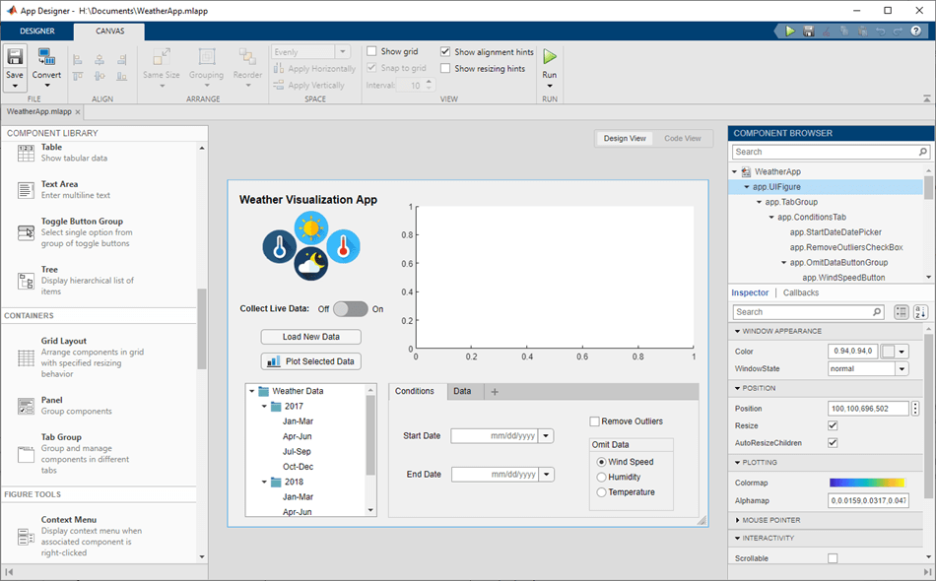
[Insert school name] MATLAB App Building Challenge
with App Building Onramp Party
Duration : 2hrs | Date: Aug 21st | Time : 10 AM | Location: Classroom
Create a MATLAB App to solve the engineering equations and win exciting prizes!
Participate by registering through the link:
Google/Microsoft form for registration
Prizes
Top 3 Winners: Goodie bag of MATLAB Swag
Top 10 Winners: MathWorks T-shirts
For updates and more information on the competition join the group, MATLAB@XXXX: [Insert link here]

